Slide 1




CardioShield AI
Presented by
NavKalpana | February2026

Slide 2
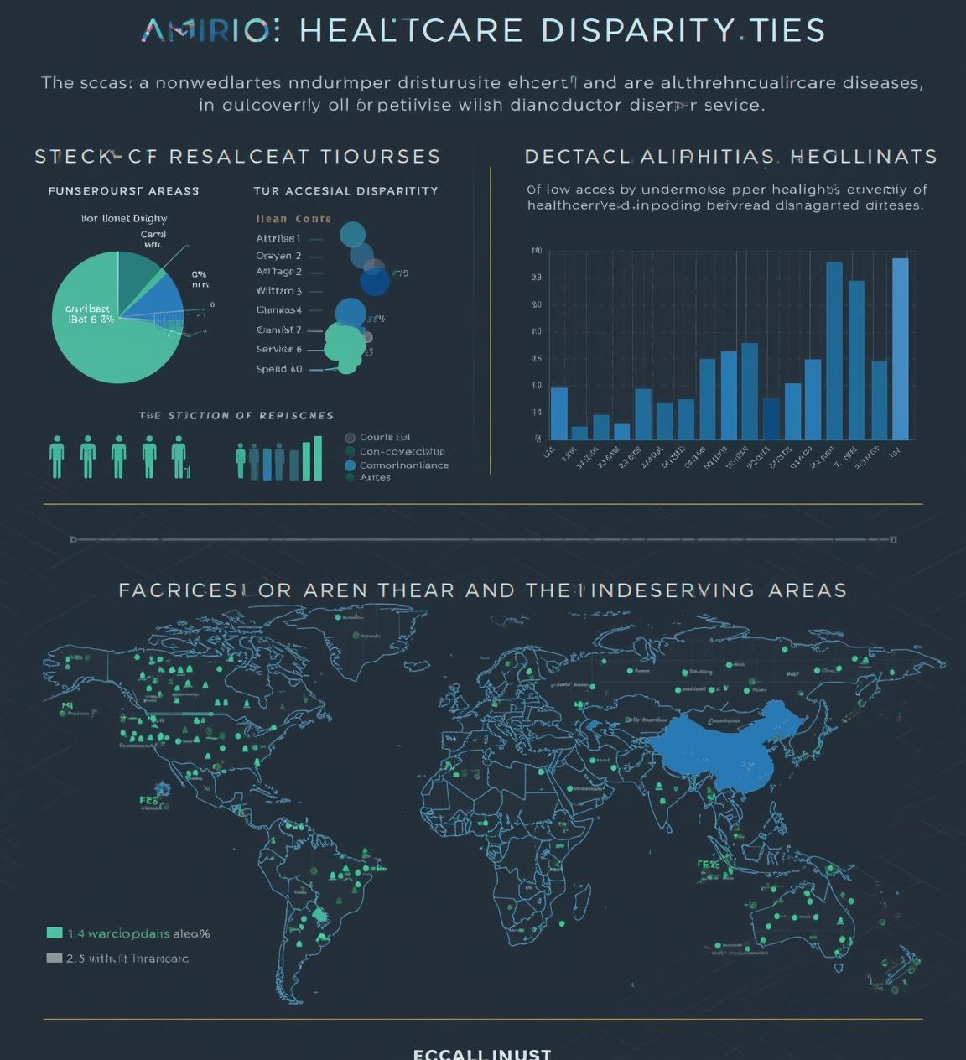
The Problem
Critical Cardiovascular Disease Statistics
Cardiovascular diseases claim approximately 17.9 million lives each year globally, highlighting the urgent need for early detection, effective screening, and accessible healthcare solutions for all populations.

Slide 3

Limitations of Current Methods
Existing Tests and AI Tools
Current cardiovascular risk assessment methods are expensive and often lack explainability. Traditional risk scores do not suit South Asian populations, leading to high false negatives in early detection.

Slide 4
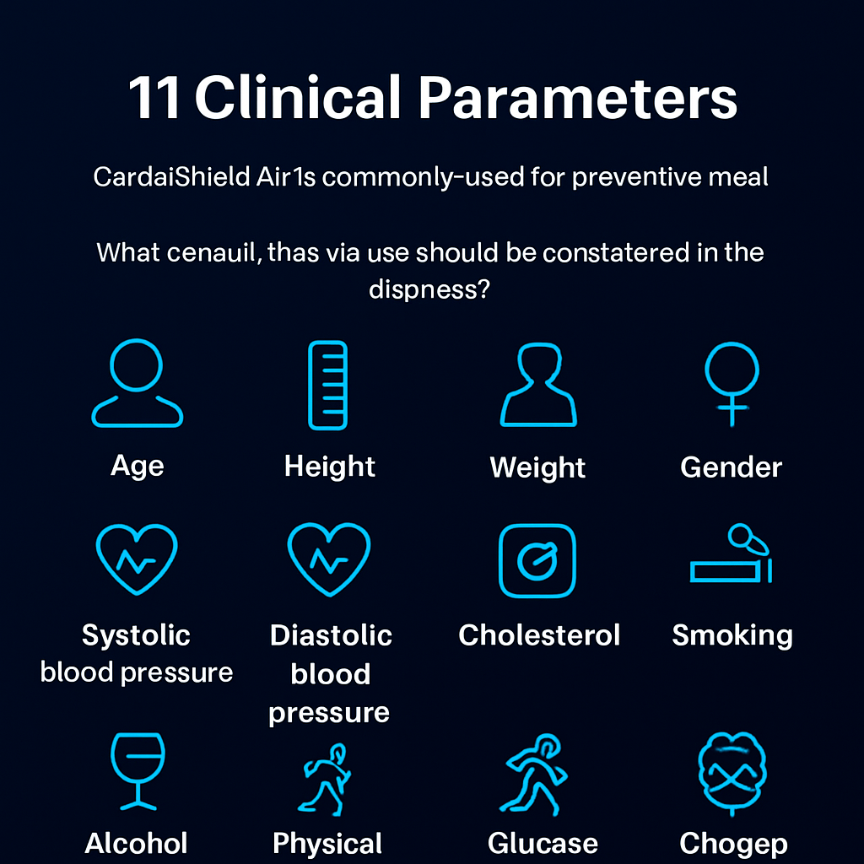
Our Solution
Overview of CardioShield AI Features
CardioShield AI leverages 11 essential clinical parameters for cardiovascular risk prediction, eliminating the need for costly lab tests, thus ensuring accessibility for underserved populations in need.

Slide 5
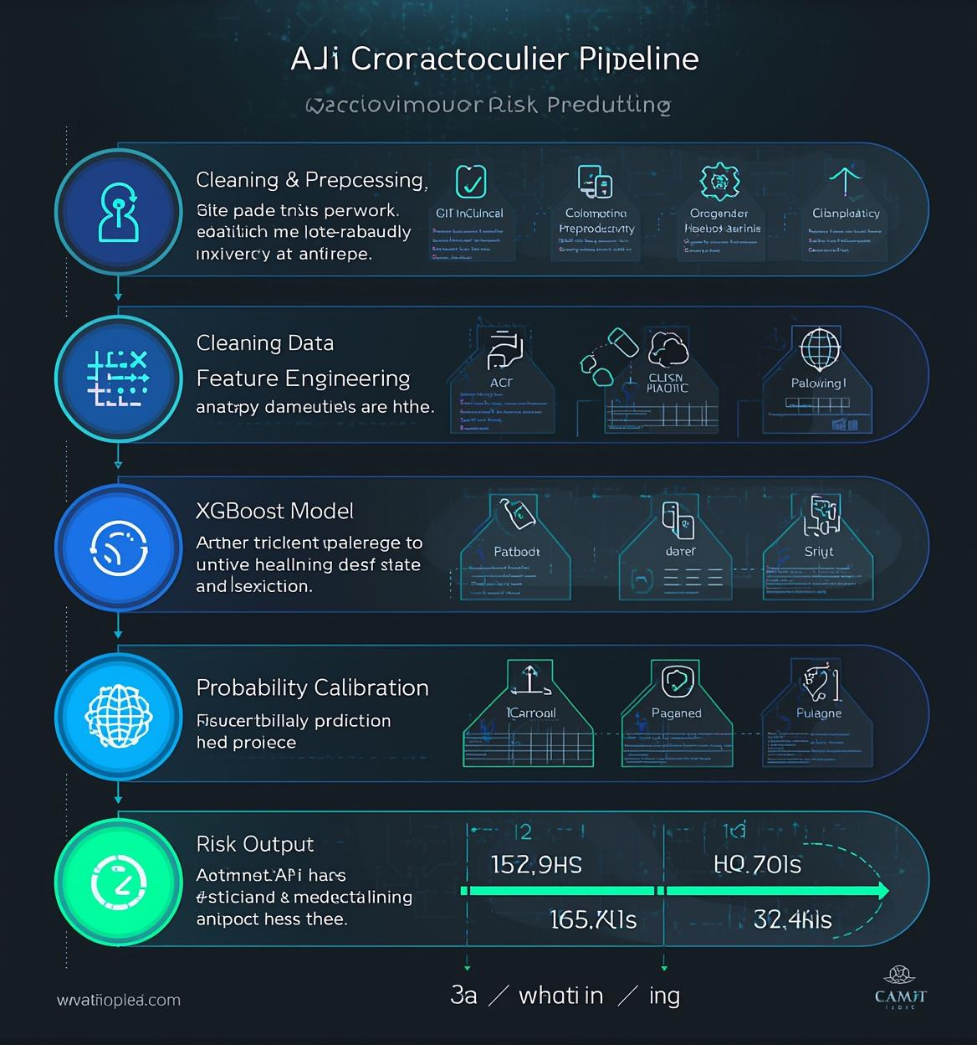
AI Processing Pipeline
The CardioShield AI pipeline encompasses essential steps including data input, cleaning, feature engineering, and model prediction using advanced techniques. This structured approach ensures high accuracy and interpretability, enabling effective cardiovascular risk stratification and timely intervention for at-risk individuals.

Slide 6

System Architecture
Overview of Technical Stack Components
The architecture consists of a React frontend, Node.js backend, and a Python-based ML service, ensuring efficient real-time performance with a microservices approach and seamless data flow.

Slide 7

Model Development
Performance Metrics and Dataset Overview
The dataset consists of 70,000 records with 11 raw features and 5 engineered features, enabling comparison of various models including XGBoost, which achieved the highest performance metrics.

Slide 8

High Recall
In healthcare, prioritizing high recall is essential for identifying high-risk patients. This approach minimizes the risk of false negatives, ensuring timely interventions. By focusing on recall, CardioShield AI enhances early detection capabilities and improves patient outcomes through proactive risk management and timely medical responses.

Slide 9
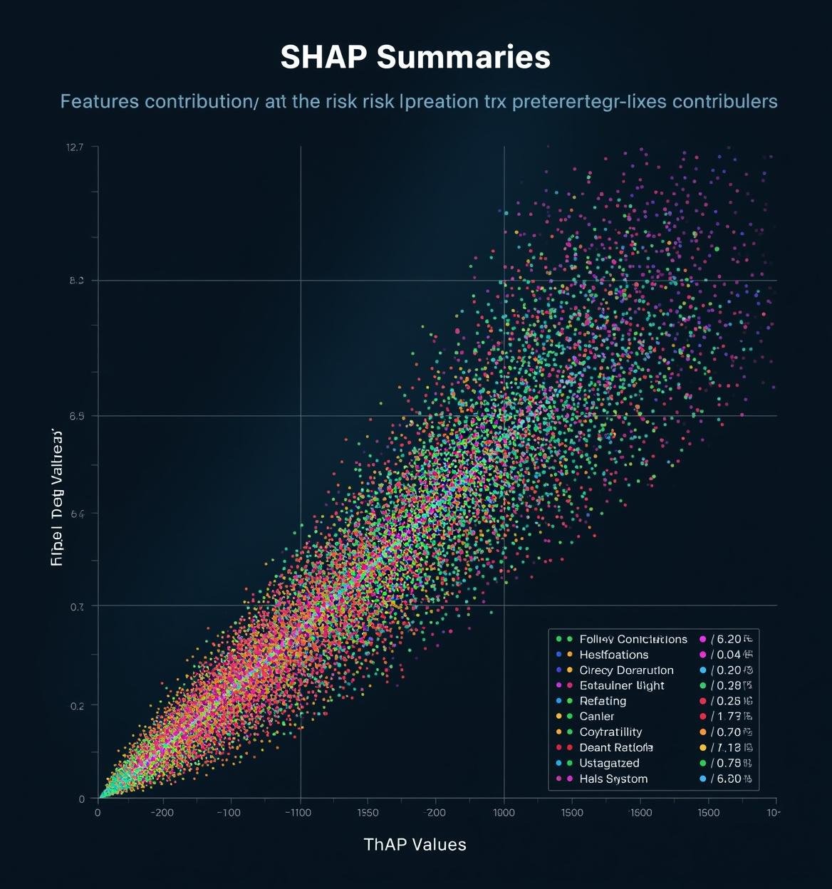
Explainable AI
SHAP (SHapley Additive exPlanations) values enhance transparency by providing insights into individual predictions. By highlighting the influence of various features, including systolic blood pressure and age, healthcare professionals can better understand risk factors, enabling informed patient discussions and personalized care strategies.

Slide 10

Counterfactuals
Understanding what-if scenarios allows healthcare professionals to visualize the potential impact of lifestyle changes on cardiovascular risk. For example, reducing blood pressure from 160 to 120 can significantly lower risk percentages, aiding in patient counseling and promoting proactive health management.

Slide 11

User Interaction Flow
Stepwise guide to using CardioShield
The user flow illustrates the seamless steps from login to risk prediction, ensuring an intuitive experience that empowers users to make informed health decisions efficiently.

Slide 12

Impact
CardioShield AI offers a transformative approach to cardiovascular health by ensuring low-cost screening, particularly in underserved areas. Its early detection capability significantly reduces missed high-risk patients, supports clinical triage, and ultimately enhances patient outcomes and health equity on a global scale.

Slide 13

Future Scope
CardioShield AI aims to enhance its capabilities through regional calibration focused on South Asia, integration with wearable technology for real-time monitoring, and clinical validation to ensure effectiveness. Additionally, the platform will seek partnerships with government health centers for broader deployment.

Slide 14
Thank You

